Slide 1
Ford Dealership Parts Project
Dealership Integration Program | Ford Itek Center, Madison, WI
May 5, 2016

Slide 2
Problem
Requirements
Design
Solution
Testing
Summary
Notes:
Drew

Slide 3
Initial Problem: The current dealer parts system is not compatible with dealership system
The software in place struggles with duplication errors, poor messaging, and presents overall compatibility between the two groups
Ford needs a new, uniform dealer parts system that stems from the WERS system used internally
Requirements Analysis
Design
Implementation
Testing
Evolution
Notes:
Drew

Slide 4
Problem
Requirements
Design
Solution
Testing
Summary
Notes:
Ross

Slide 5
Current System Analysis: Requirements
Clear disconnect between Ford and its dealers due to parts system incompatibility
Ensure systems are integrated throughout organization
Dealers are carrying too much inventory causing excessive spending on current assets by the company and dealerships
Utilize ability to monitor inventories at branch locations
Navigating current parts database is taxing and causes losses in productivity
Train dealers to effectively maintain inventory through use of system
Notes:
Ross

Slide 6
Problem
Requirements
Design
Solution
Testing
Summary
Notes:
Zach

Slide 7
Addressing Problem: Design new dealership parts management system
Goals:
Reduce inventory held by dealerships
Maintain WERS as the single data source for parts information
Launch the Extend WERS parts system
Increase dealership satisfaction
Notes:
Zach

Slide 8
Problem
Requirements
Design
Solution
Testing
Summary
Notes:
Ross

Slide 9
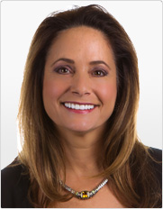
Solution: Booz Allen Hamilton
Who we are:
Fortune 500 firm specializing in strategy and technology consulting
Relevant office locations: Chicago, IL and Troy, MI
Specific work:
Change management, improving cyber capabilities, combating global terrorism, protecting the environment
Who we serve:
All branches of the US military
Department of Defense
Department of Homeland Security
Large international corporations
Karen Dahut
Notes:
Ross

Slide 10

Proposed Solution: Route to efficient inventory management
Centralize Information
Simplify Access
Constant Data Transparency
Platform for Future Expansion
Notes:
Ross

Slide 11
Proposed Solution: View of efficient inventory management
Single WERS Database
Integrated Dealer Portal
Better inventory management with less disconnect between Ford and its dealers.
Ease of use for dealers will help in dealer adoption which is essential to project success.
Perpetual Inventory Tracking
Scalability
Increased transparency (accountability) and decreased inventory held by dealers.
Easily expanded to dealerships and dealership groups outside North America.
Notes:
Zach

Slide 12
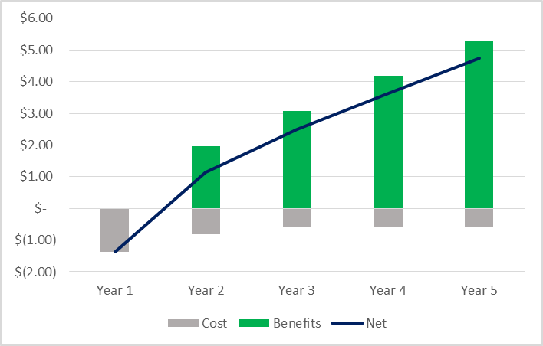
Proposed Solution: Project benefits exceed Ford’s expectations
NPV (@ 8% WACC) = $7.5mm+
Positive NPV project with multiple intangible benefits
IRR = 133%
Greater than Ford’s 55% minimum required rate of return for development projects
in $mm
Notes:
Drew

Slide 13
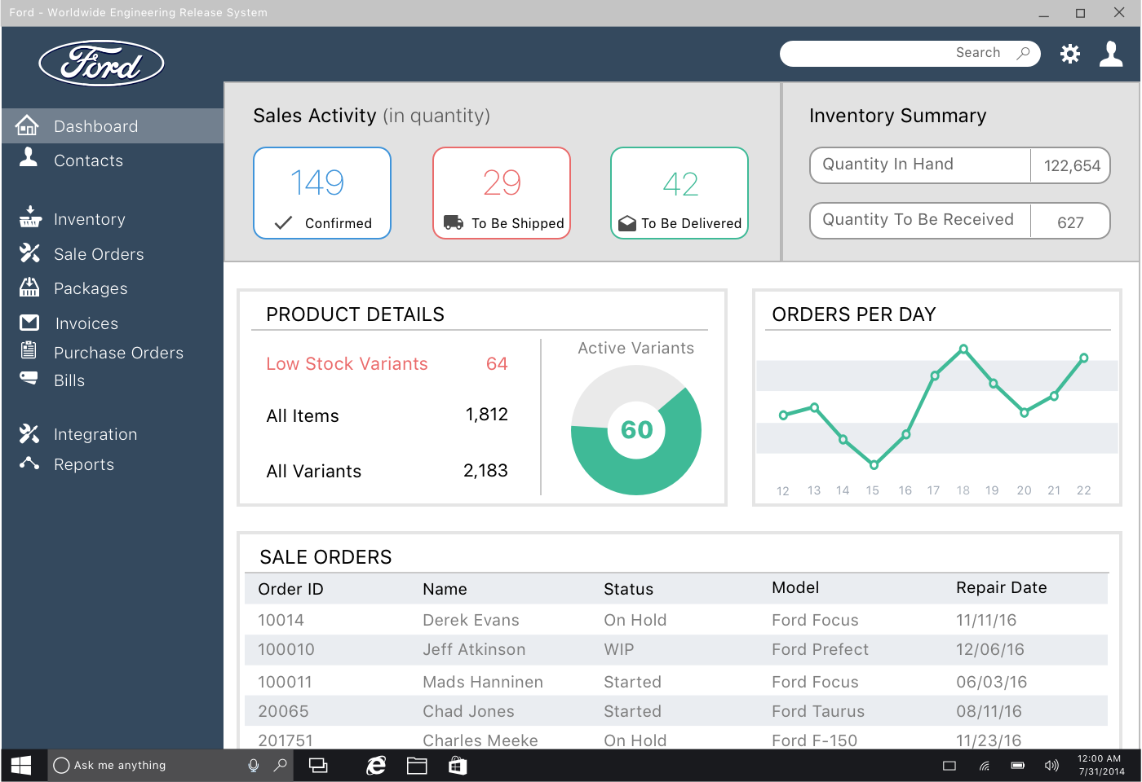
Proposed Solution: Screenshots
Notes:
Zach

Slide 14
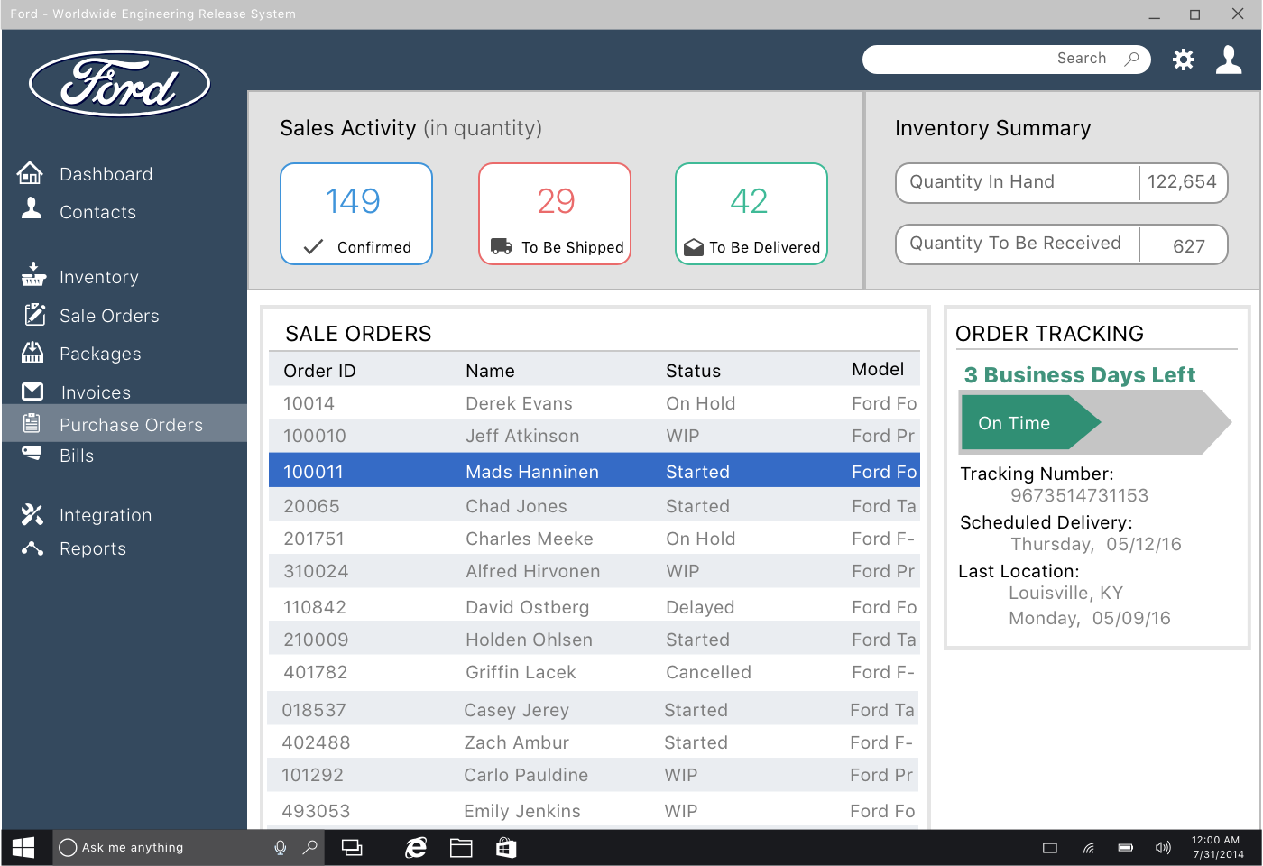
Proposed Solution: Screenshots
Notes:
Zach

Slide 15
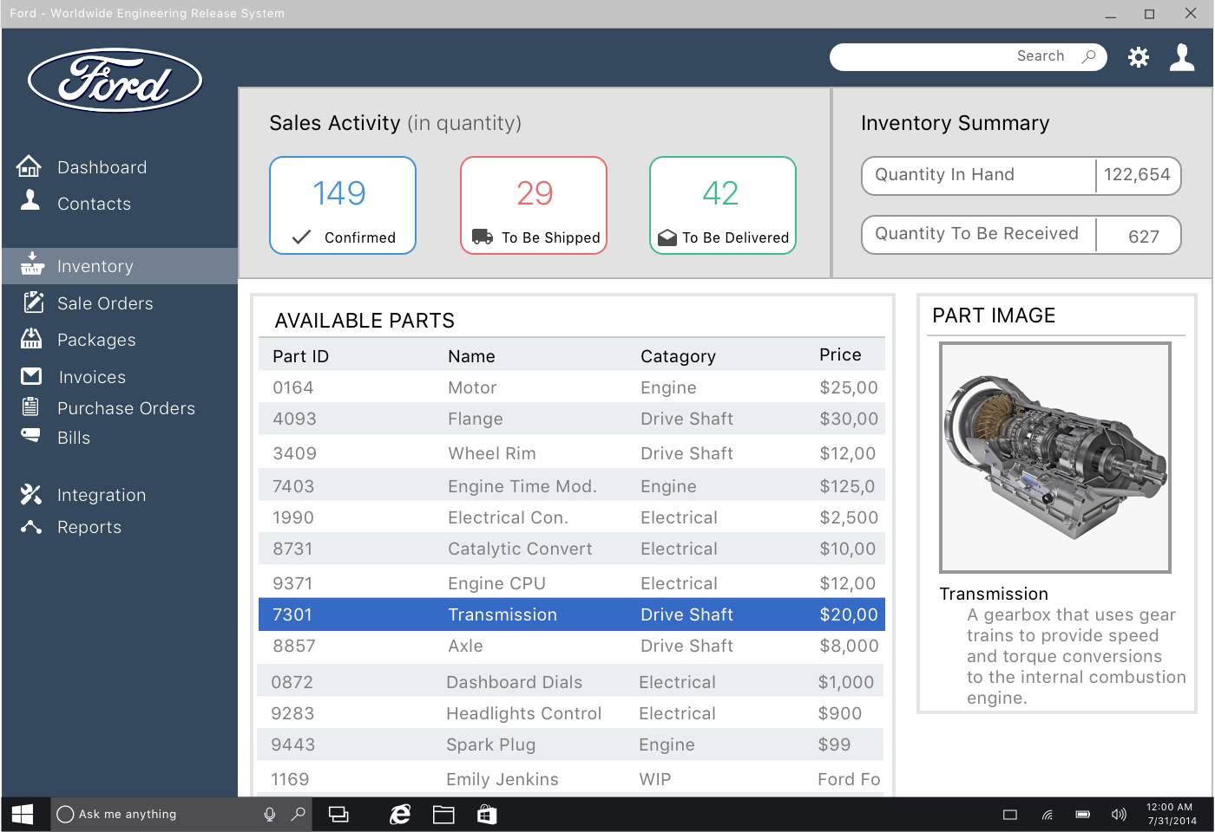
Proposed Solution: Screenshots
Notes:
Zach

Slide 16
Problem
Requirements
Design
Solution
Testing
Summary
Notes:
Ross

Slide 17
Testing: Continued support through successful implementation
Value satisfaction both from Ford and its dealerships
Measure our success and success of the project based on adoption rate and built satisfaction by dealers
To help satisfaction of dealerships:
Goal to release versions before final with hope to receive feedback from North American Dealers and Dealership Systems
Take feedback into consideration in final design and implementation
Notes:
Ross

Slide 18
Problem
Requirements
Design
Solution
Testing
Summary
Notes:
Ross

Slide 19
Summary
Achieve successful change in the organization through proper design, implementation, testing, and iteration
Booz Allen Hamilton’s solution aligns with the organization as a whole, from large organizational initiatives, to dealership concerns
Booz Allen Hamilton’s experience with large, complex governmental systems makes the perfect match for this project
Notes:
Ross

